Slide 1
CHAPTER 7:
RELATIONAL ALGEBRA AND RELATIONAL CALCULUS
BCI2023 – DATABASE SYSTEMS
SEM I 2007/08

Slide 2
Learning Outcomes
Apply the data manipulation using the relational algebra language and relational calculus language
Apply mathematical concepts related to the relational algebra and the relational calculus
Perform fundamental operations in the relational algebra such as selection, projection, union, set difference and intersection
Know types of joint operations
Learn examples of queries of tuple relational calculus and domain relational calculus.
© Pearson Education Limited 1995, 2005

Slide 3
Introduction
Relational algebra and relational calculus
  formal languages associated with the relational model.
Relational algebra
  a (high-level) procedural language and relational calculus a non-procedural language.
However, formally both are equivalent to one another.
A language that produces a relation that can be derived using relational calculus is relationally complete.
© Pearson Education Limited 1995, 2005

Slide 4
Relational Algebra
Relational algebra operations
  work on one or more relations to define another relation without changing the original relations.
Both operands and results are relations, so output from one operation can become input to another operation.
Allows expressions to be nested, just as in arithmetic. This property is called closure.
© Pearson Education Limited 1995, 2005

Slide 5
Relational Algebra
Five basic operations in relational algebra:
  Selection
  Projection
  Cartesian product
  Union
  Set Difference.
These perform most of the data retrieval operations needed.
Also have Join, Intersection, and Division operations, which can be expressed in terms of 5 basic operations.
© Pearson Education Limited 1995, 2005

Slide 6
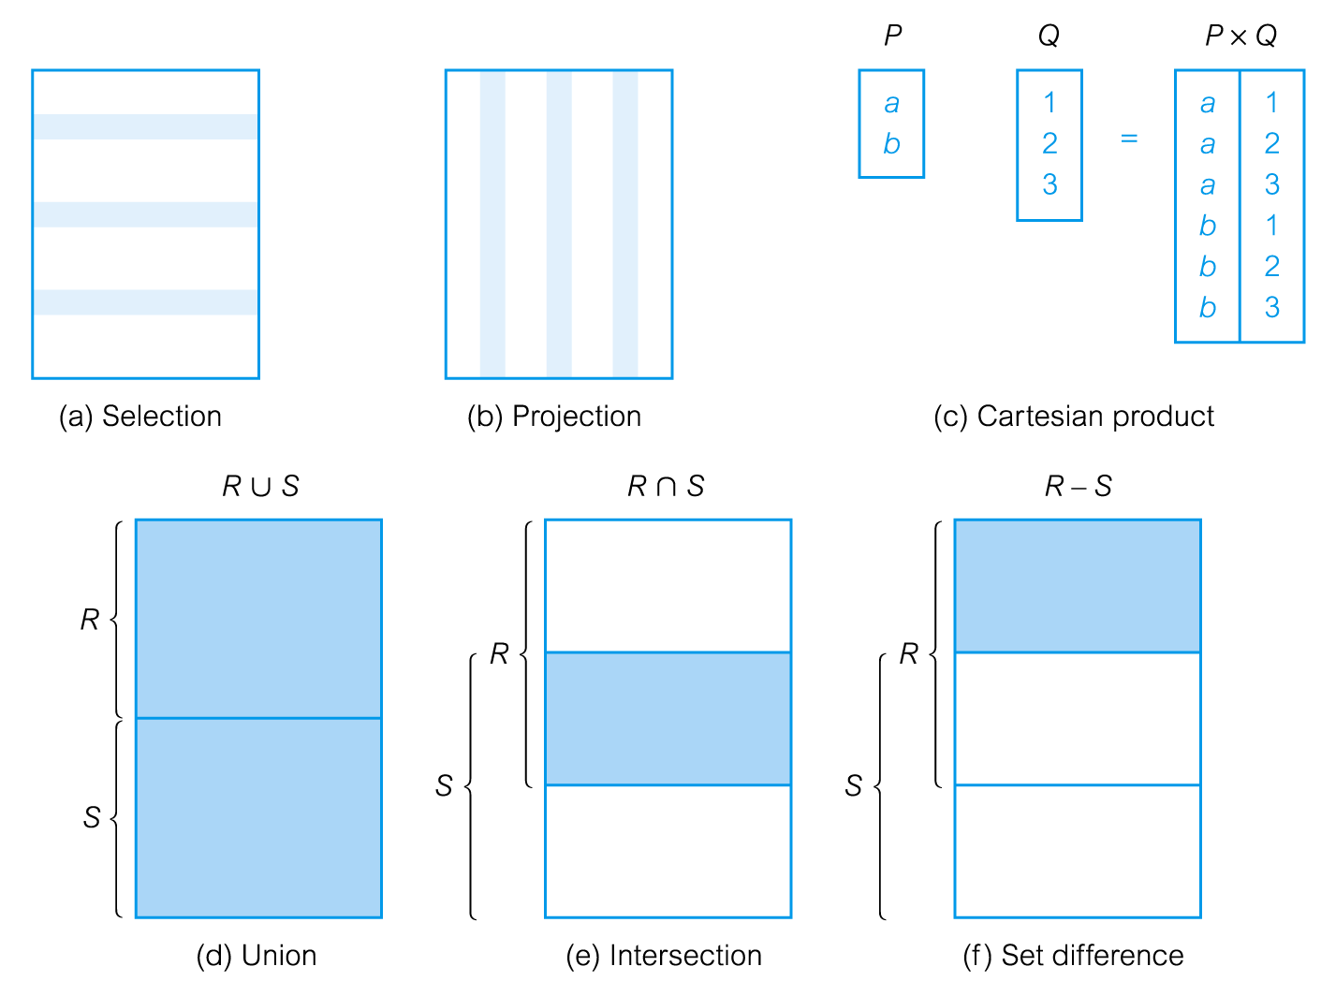
Relational Algebra Operations
© Pearson Education Limited 1995, 2005

Slide 7
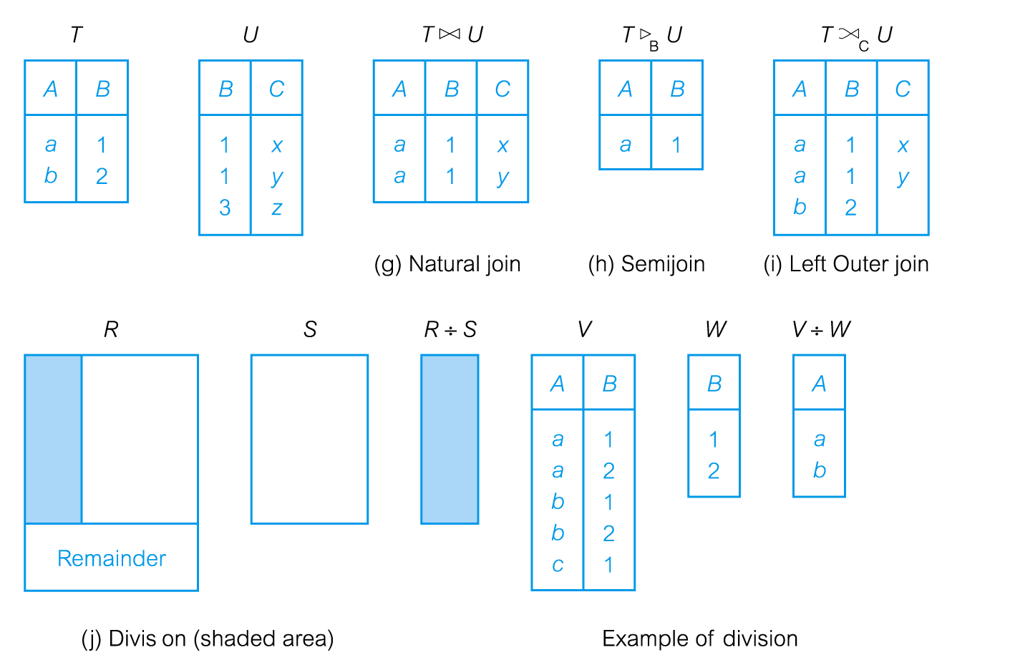
Relational Algebra Operations
© Pearson Education Limited 1995, 2005

Slide 8
Relational Algebra Operations
© Pearson Education Limited 1995, 2005

Slide 9
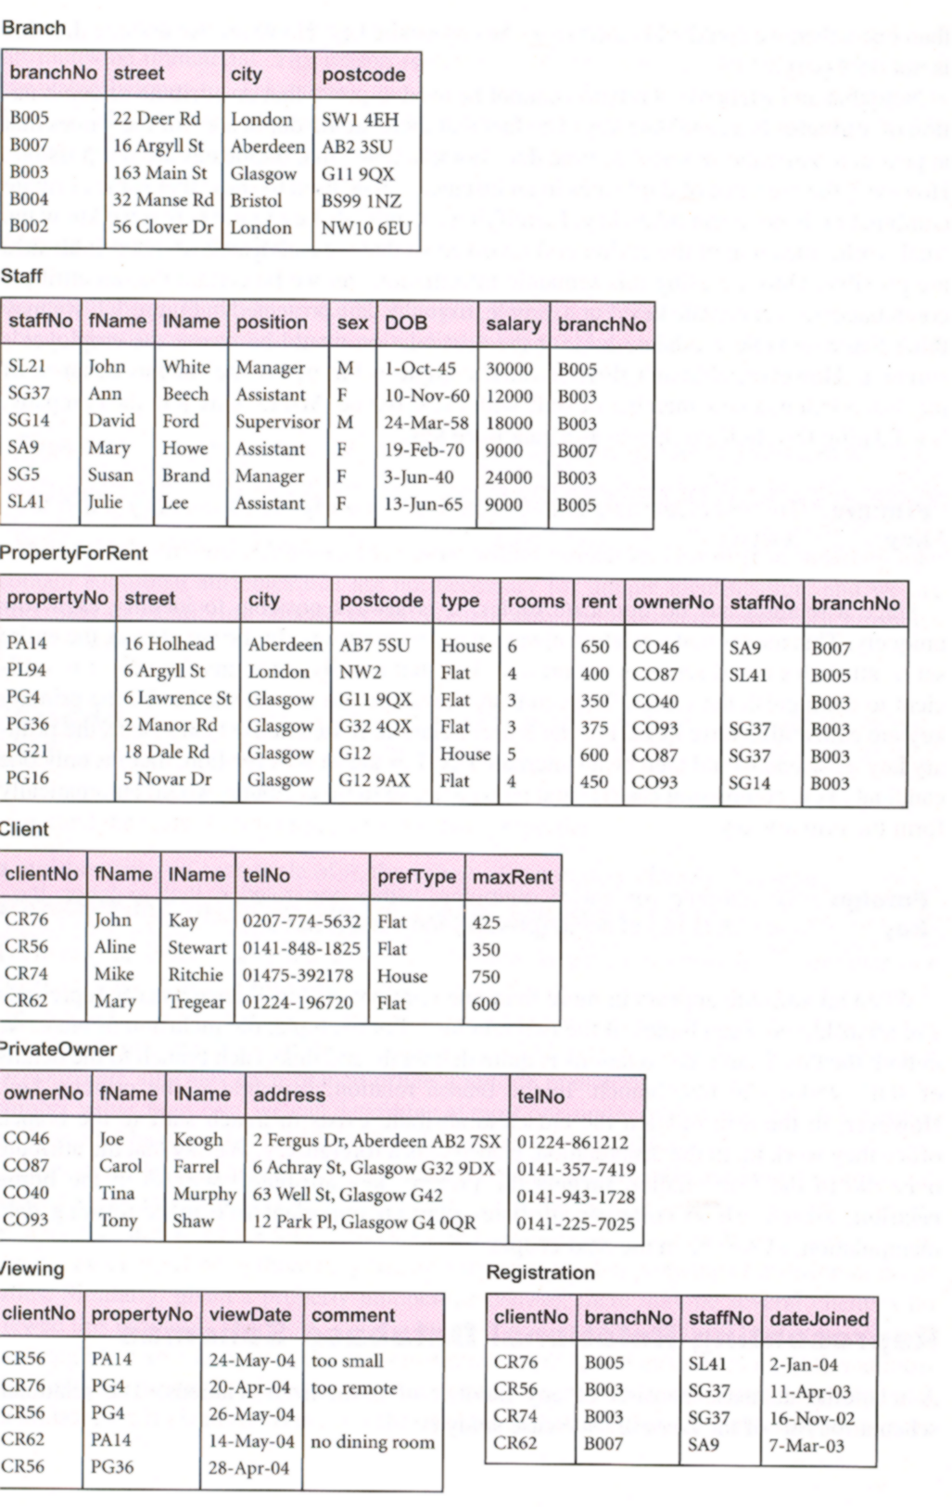

Slide 10
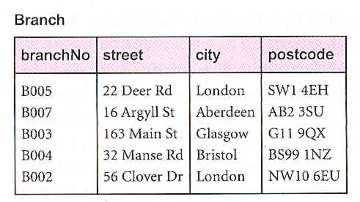
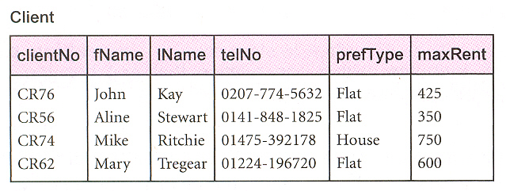
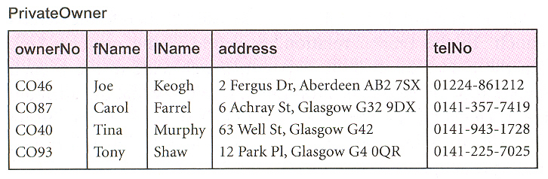
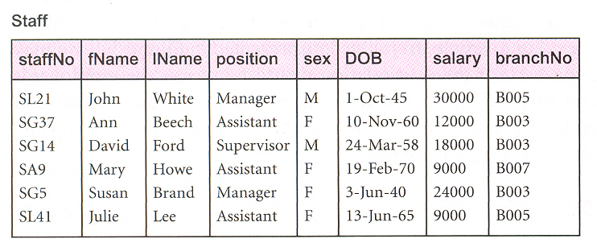
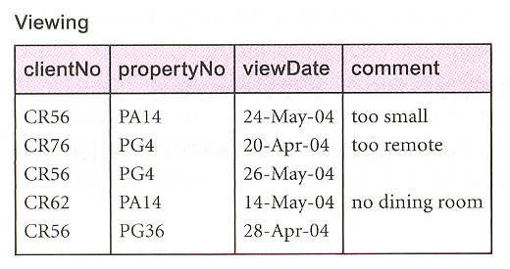
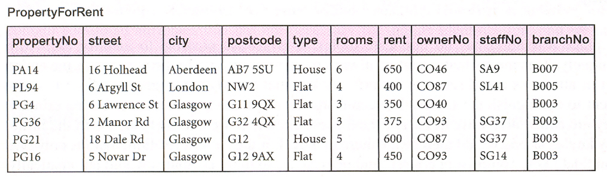
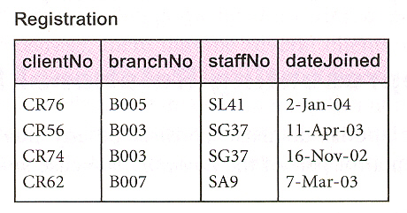
Instance of DreamHome rental database

Slide 11
Selection (or Restriction)
σ_{predicate} (R)
  Works on a single relation R and defines a relation that contains only those tuples (rows) of R that satisfy the specified condition (predicate).
© Pearson Education Limited 1995, 2005

Slide 12
Selection (or Restriction)
List all staff with a salary greater than £10,000.
  σ_{salary > 10000} (Staff)

Slide 13
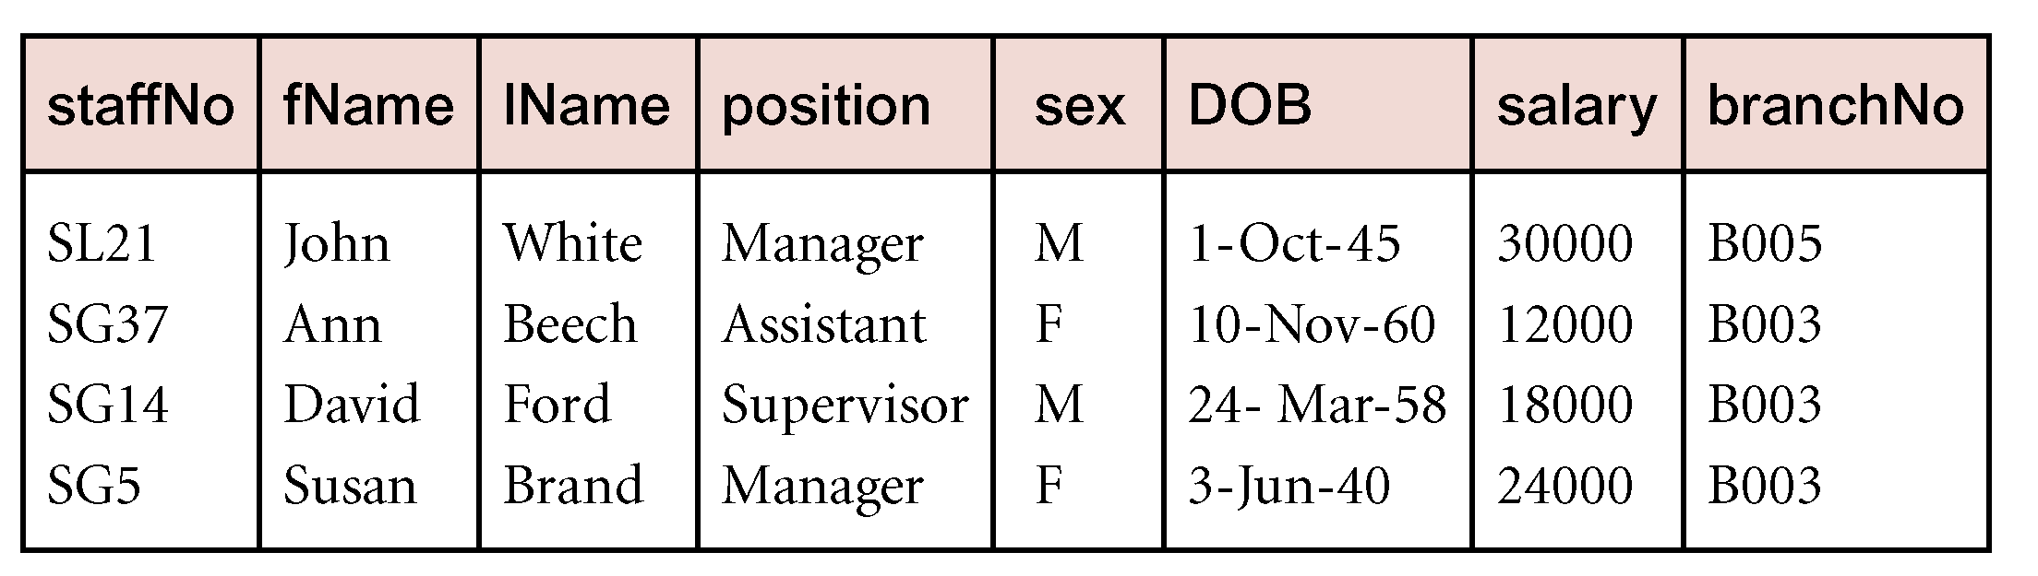
Example - Selection (or Restriction)
List all staff with a salary greater than £10,000.
  σ_{salary > 10000} (Staff)
© Pearson Education Limited 1995, 2005

Slide 14
Relational Algebra Operations
© Pearson Education Limited 1995, 2005

Slide 15
Projection
Π_{col1, . . . , coln}(R)
  Works on a single relation R and defines a relation that contains a vertical subset of R, extracting the values of specified attributes and eliminating duplicates.
© Pearson Education Limited 1995, 2005

Slide 16
Projection
Produce a list of salaries for all staff, showing only staffNo, fName, lName, and salary details.
  Π_{staffNo, fName, lName, salary}(Staff)
© Pearson Education Limited 1995, 2005

Slide 17
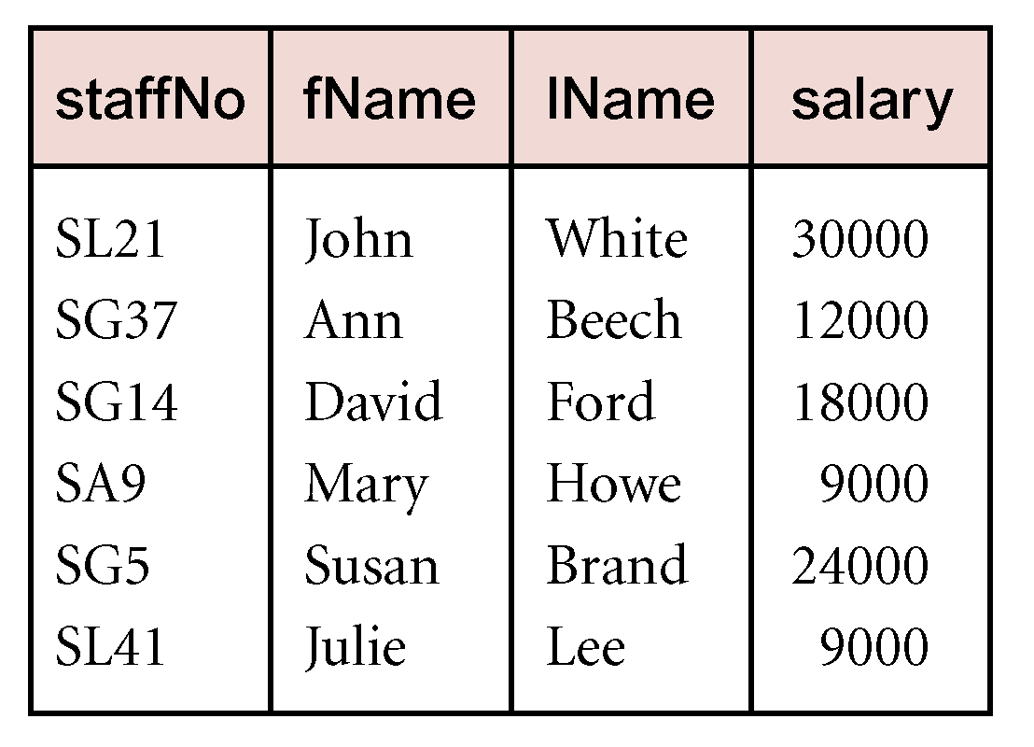
Example - Projection
Produce a list of salaries for all staff, showing only staffNo, fName, lName, and salary details.
  Π_{staffNo, fName, lName, salary}(Staff)
© Pearson Education Limited 1995, 2005

Slide 18
Relational Algebra Operations
© Pearson Education Limited 1995, 2005

Slide 19
Union
R ∪ S
  Union of two relations R and S defines a relation that contains all the tuples of R, or S, or both R and S, duplicate tuples being eliminated.
  R and S must be union-compatible.
If R and S have I and J tuples, respectively, union is obtained by concatenating them into one relation with a maximum of (I + J) tuples.
© Pearson Education Limited 1995, 2005

Slide 20
Union compatible
both have same schema and the matching attributes have the same domain.
 Two relations H1 and H2 are union-compatible if H1 and H2 have the same degree and the matching attributes in H1 and H2 have the same domain. 

Slide 21
Example - Union
List all cities where there is either a branch office or a property for rent.
  Π_{city}(Branch) ∪ Π_{city}(PropertyForRent)
© Pearson Education Limited 1995, 2005

Slide 22

Example - Union
List all cities where there is either a branch office or a property for rent.
  Π_{city}(Branch) ∪ Π_{city}(PropertyForRent)
© Pearson Education Limited 1995, 2005

Slide 23
Relational Algebra Operations
© Pearson Education Limited 1995, 2005

Slide 24
Set Difference
R – S
  Defines a relation consisting of the tuples that are in relation R, but not in S.
  R and S must be union-compatible.
© Pearson Education Limited 1995, 2005

Slide 25
Example - Set Difference
List all cities where there is a branch office but no properties for rent.
  Π_{city}(Branch) – Π_{city}(PropertyForRent)
© Pearson Education Limited 1995, 2005

Slide 26
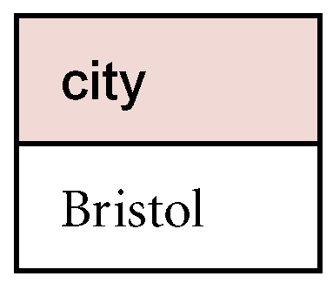
Example - Set Difference
List all cities where there is a branch office but no properties for rent.
  Π_{city}(Branch) – Π_{city}(PropertyForRent)
© Pearson Education Limited 1995, 2005

Slide 27
Relational Algebra Operations
© Pearson Education Limited 1995, 2005

Slide 28
Intersection
R ∩ S
  Defines a relation consisting of the set of all tuples that are in both R and S.
  R and S must be union-compatible.
Expressed using basic operations:
  R ∩ S = R – (R – S)
© Pearson Education Limited 1995, 2005

Slide 29
Example - Intersection
List all cities where there is both a branch office and at least one property for rent.
  Π_{city}(Branch) ∩ Π_{city}(PropertyForRent)
© Pearson Education Limited 1995, 2005

Slide 30
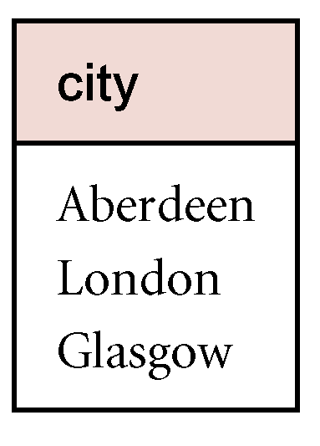
Example - Intersection
List all cities where there is both a branch office and at least one property for rent.
  Π_{city}(Branch) ∩ Π_{city}(PropertyForRent)
© Pearson Education Limited 1995, 2005

